Slide 1
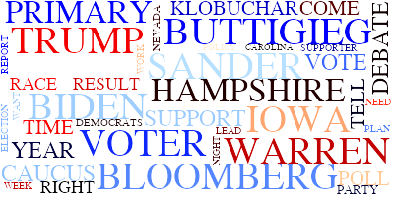
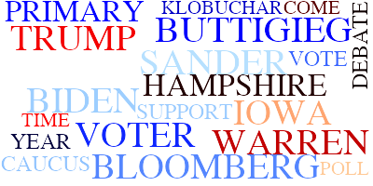
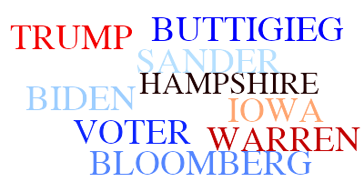
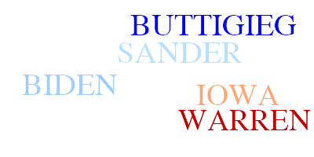
Tracking Media Topics
Using Natural Language Processing
And
Unsupervised Learning
Michael Boals

Slide 2

Media Culture
‘Whoever controls the media, the images, controls the culture.’ - Allen Ginsberg, Author
‘We live in a media culture and whoever controls and influences and uses the media the best has the power for change.’
- Paul Watson, Founder, Sea Shephard
‘The Queen is hiring a social media manager’
-CNN
Notes:
We live in a culture that is hyper focused on media.
We all have social media accounts. The President regularly communicates through social media. And now even the Queen of England is hiring a social media manager.
We also know that online companies have been using NLP and sentiment analysis to monitor user’s activity for years.
I wondered if maybe the media focused public could use the same tools to track media content.
I chose to analyze the reporting on the candidates in the presidential primary.

Slide 3

Goals
Accurately Identify Reporting Topics
Characterize Sentiment
Track Changes Over Time
Notes:
Can we do all this with unsupervised learning learning?

Slide 4








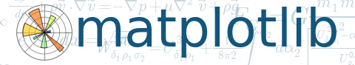

Methodology
Scrape, Clean and Store Data
Compare Modelling Options
Apply Best Model to
Data and Explore
pyLDAvis
Notes:
Microsoft Azure News Search API provided links.
Scraped 3,800 Articles directly from publishers’ web sites.
Clean corpus was 2.8M Words for 7 weeks worth of articles.
Finding the right filters for the corpus was one of the more time-consuming parts of this project.

Slide 5
Modelling
Vectorizers
Count Vectorizer
TF-IDF
Topic Models
LDA
Truncated SVD
PCA - Kmeans
Notes:
Used 2 different vectorizers: CountVectorizer, TF-IDF
All three techniques generated similar topics but the LDA were the most distinct

Slide 6
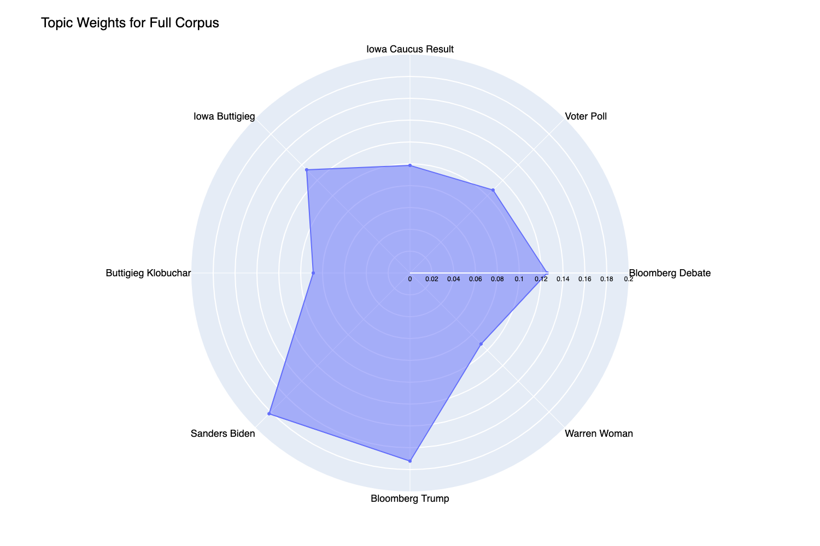
Topics
1: Bloomberg Debate
2: Voter Poll
3: Iowa Caucus Result
4: Iowa Buttigieg
5: Buttigieg Klobuchar
6: Sanders Biden
7: Bloomberg Trump
8: Warren Woman
Notes:
Explain a radar plot.
Distance from the center is the importance of that topic.
While the search terms were the candidate names the topic modeling identified relevant topics other than the candidates.

Slide 7
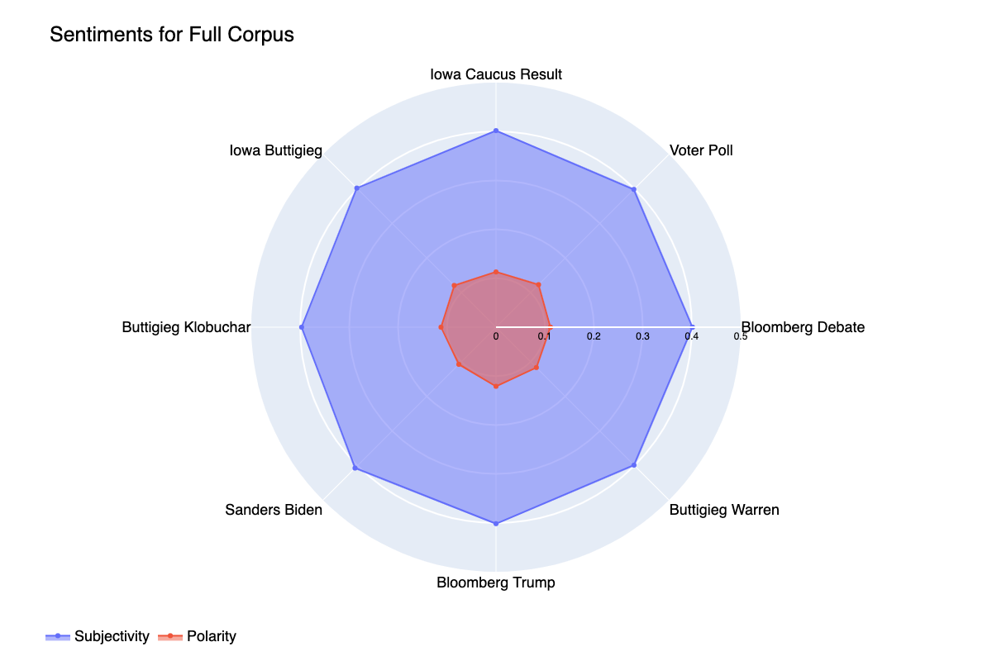
Topics
1: Bloomberg Debate
2: Voter Poll
3: Iowa Caucus Result
4: Iowa Buttigieg
5: Buttigieg Klobuchar
6: Sanders Biden
7: Bloomberg Trump
8: Warren Woman
Notes:
I used TextBlob for sentiment analaysis.
Subjectivity is fairly consistent but still somewhat subjective for the news.
Polarity ranges from -1 to 1 and reporting is more polarizing for some topics.
These are average scores for the whole corpus. There were some outliers but the both positive and negative but the distribution was closely clustered around the average.

Slide 8
Time Study
Topics for Feb 2 Week
1: Trump Sanders Debate
2: Steyer Poll
3: People Just Right
4: Iowa Event
5: Biden Hampshire
6: Bloomberg Primary
7: Iowa Caucus Result
8: Buttigieg Warren
Notes:
As I mentioned, one of the goals of this project was to see if topic modeling could be used to track topic reporting over time.
I picked a significant event in the time span I studied and used that week as the base corpus for creating a model.
I fit a model using the copus of reporting for the week of the event and then transformed the corpuses of the week before and two weeks after. In effect, projecting the reporting of those weeks onto the topic modeling for the week of interest.

Slide 9
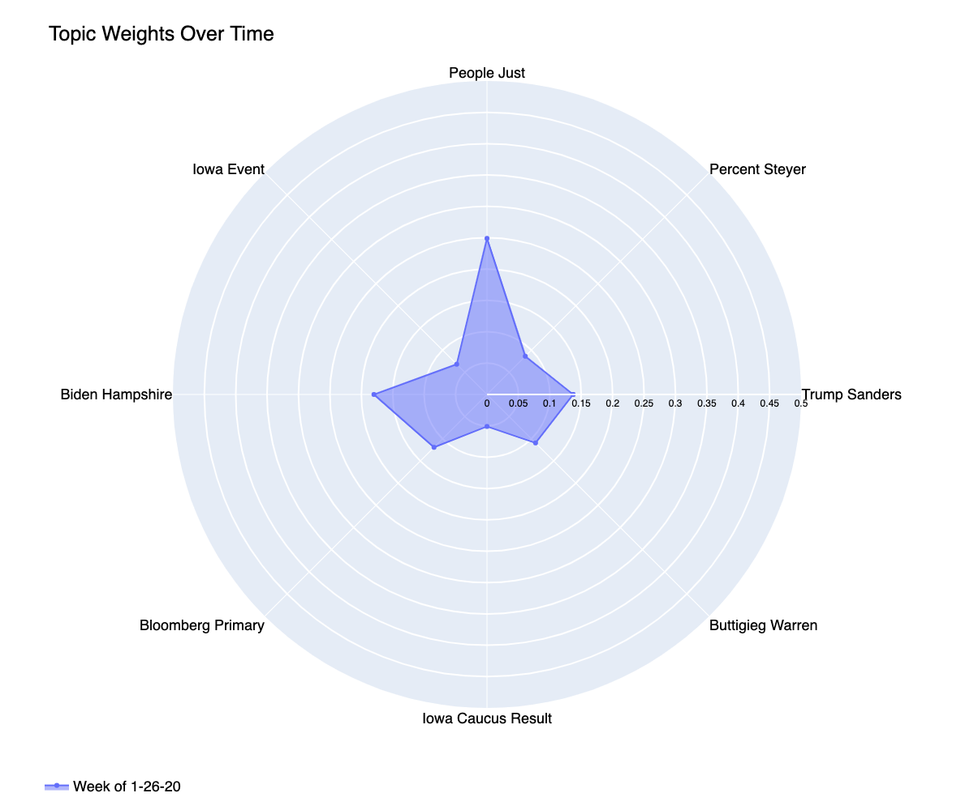
Time Study
Topics for Feb 2 Week
1: Trump Sanders Debate
2: Steyer Poll
3: People Just Right
4: Iowa Event
5: Biden Hampshire
6: Bloomberg Primary
7: Iowa Caucus Result
8: Buttigieg Warren

Slide 10
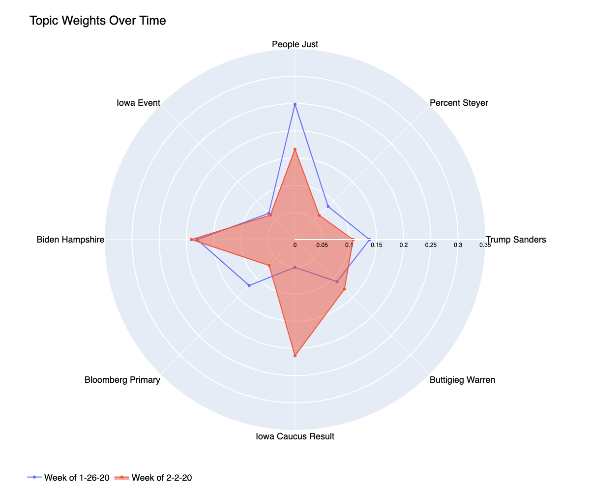
Time Study
Topics for Feb 2 Week
1: Trump Sanders Debate
2: Steyer Poll
3: People Just Right
4: Iowa Event
5: Biden Hampshire
6: Bloomberg Primary
7: Iowa Caucus Result
8: Buttigieg Warren

Slide 11
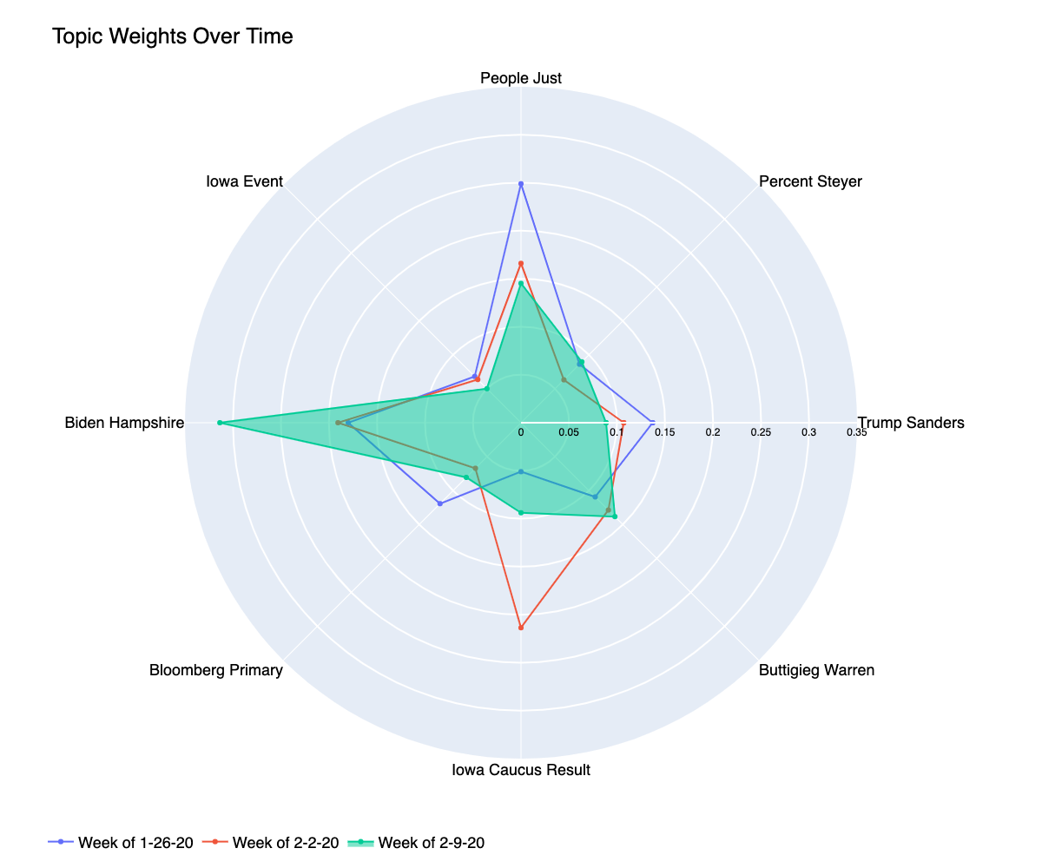
Time Study
Topics for Feb 2 Week
1: Trump Sanders Debate
2: Steyer Poll
3: People Just Right
4: Iowa Event
5: Biden Hampshire
6: Bloomberg Primary
7: Iowa Caucus Result
8: Buttigieg Warren

Slide 12
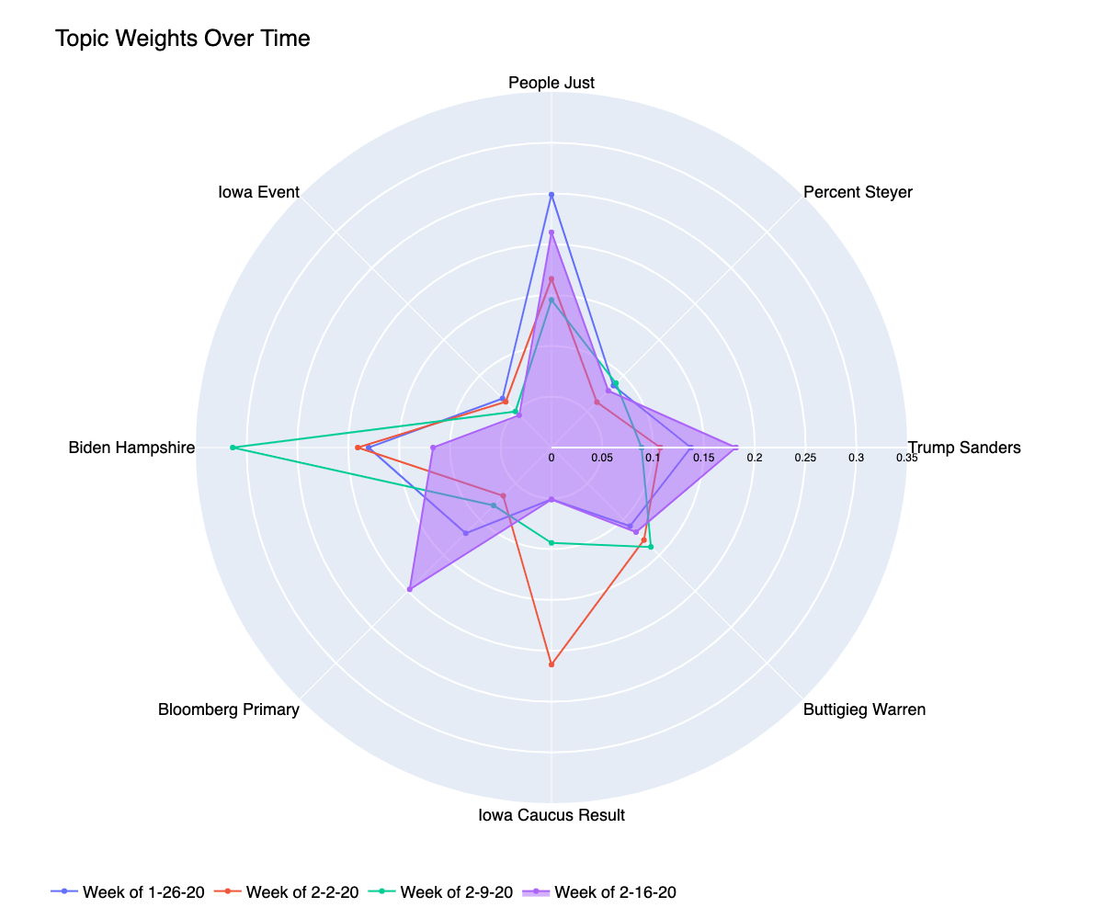
Time Study
Topics for Feb 2 Week
1: Trump Sanders Debate
2: Steyer Poll
3: People Just Right
4: Iowa Event
5: Biden Hampshire
6: Bloomberg Primary
7: Iowa Caucus Result
8: Buttigieg Warren
Notes:
We see that two weeks after the reporting on the Iowa Caucus has died down and the model captures that change in activity.

Slide 13
Conclusions
Successfully Identified Relevant Topics
Successful Tracked Changes Over Time
Sentiment Analysis Was Unclear
Future Work
Improve Topic Naming Algorithm
Relate Topics Across Corpuses/Time

Slide 14
Questions?

Slide 15
Appendix:

Slide 16
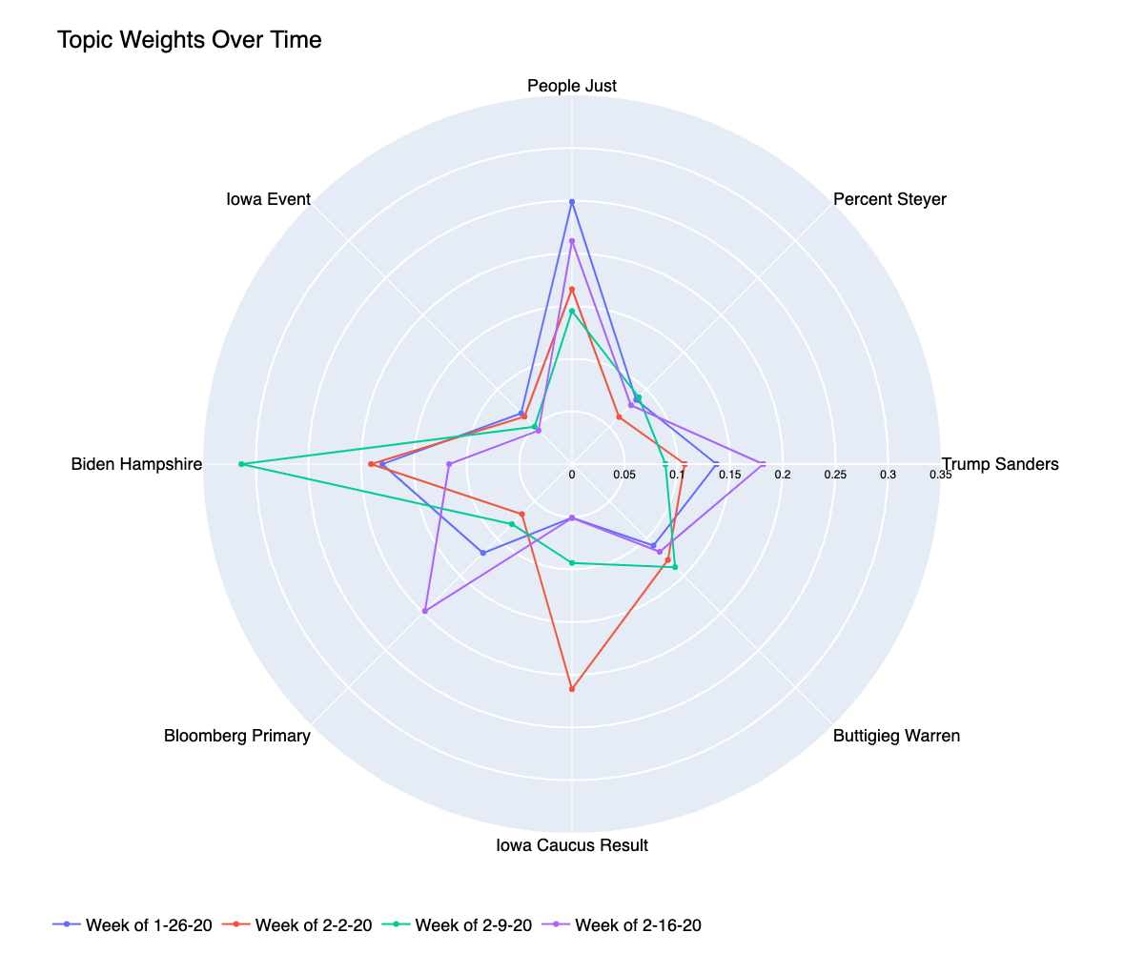
Time Study
Topics for Feb 2 Week
1: Trump Sanders Debate
2: Steyer Poll
3: People Just Right
4: Iowa Event
5: Biden Hampshire
6: Bloomberg Primary
7: Iowa Caucus Result
8: Buttigieg Warren

Slide 17
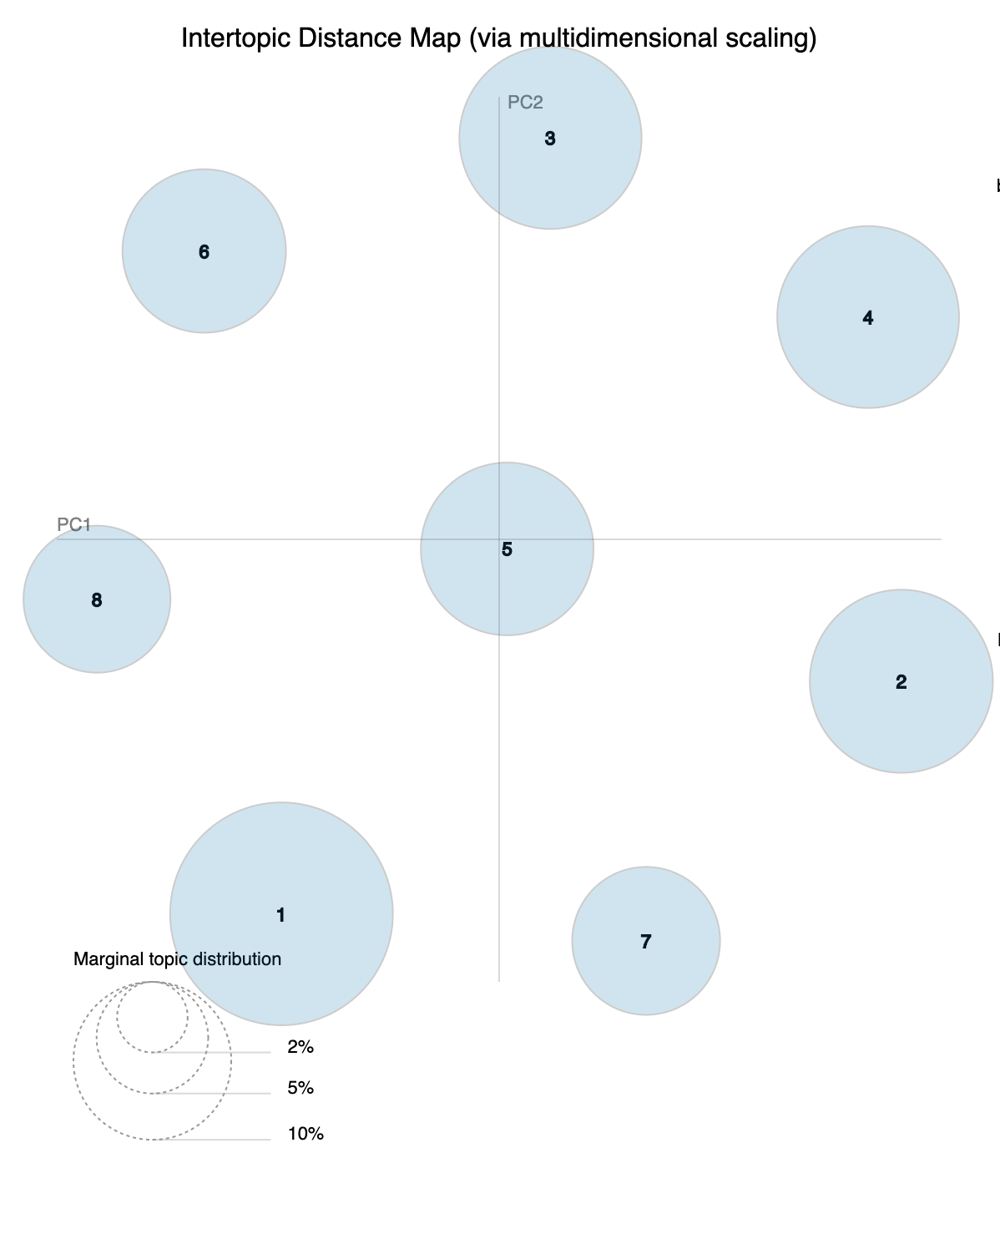
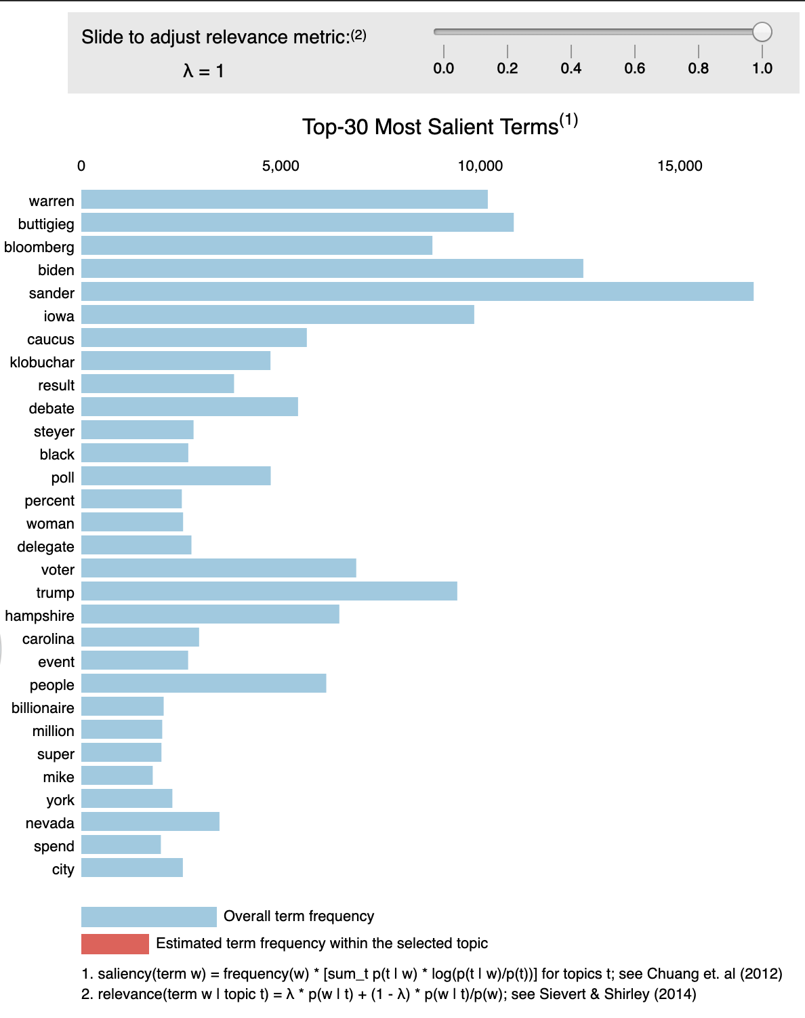
pyLDAvis For Full Corpus

Slide 18
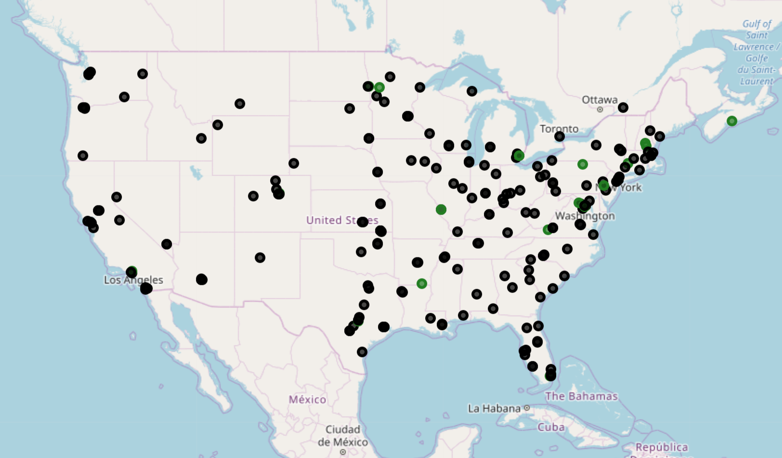
Publication Locations

